Slide 1
MSE 311: Thermodynamics of Materials
Lecture 12: The behavior of solutions
Weishu Liu
Department of Materials Science and Engineering
Southern University of Science and Technology (SUSTech)
Email: liuws@sustech.edu.cn
Office: Wisdom Valley Block 1#, Rm202

Slide 2
real gas mixtures
Idea gas mixture : the molar Gibbs free energy of an ideal gas is a linear function of the logarithm of the pressure of the gas
Real gas mixture : the molar Gibbs free energy of an ideal gas is not a linear function of the logarithm of the pressure of the gas
People define a new function fugacit f, in place of P, to keep the linear relationship
for standard state: f=1, T
When P→0, f→P

Slide 3
ΔG_{mix} of gas mixture
For idea gas,
PV/RT=1
For nonidea gas,
PV/RT=Z, Z=f(P)
a_{i :} activity

Slide 4
28. Raoult’s law and Henry’s law
Ref. Introduction of Thermodynamics of Materials, D. R. Gaskell, Chapter 9

Slide 5
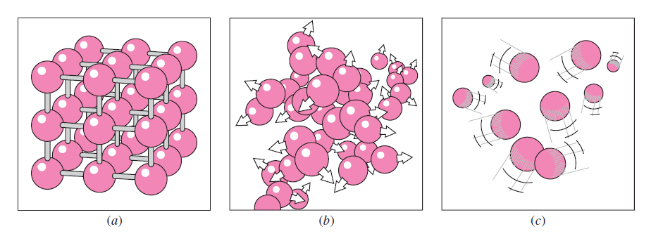
Solid, liquid, gas
From gas to liquid or solid, or condensed state,
the interaction between atoms, molecular or ions increases.

Slide 6
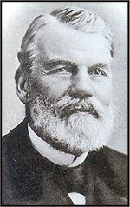
Raoult’s law
拉乌尔定律
T
François-Marie Raoult
A(l) → A(g)
French chemist
1830-1901
Evaporation rate:
determined by the surface bonding strength between atoms and density of atoms on the surface
Condensation rate:
determined by the rate of atoms strike on the liquid surface

Slide 7
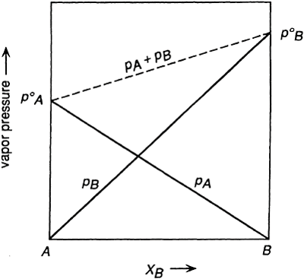
Raoult’s law
Considering pure A
At equilibrium
Consider a solution
a little liquid B was added into to liquid A
The molar fraction of A in the solution: X_{A}
Assume the fraction atom A on the surface is X_{A}
evaporation rate of A is decreased by a factor X_{A,}
vapor pressure of A is decreased from p⁰ to p

Slide 8
Raoult’s law
Raoult’s Law
The vapor pressure of the pure substance i
the vapor pressure exerted by a component i in a solution is equal to the product of the mole fraction of i in the solution and the saturated vapor pressure of pure liquid i at the temperature of the solution
the components of a solution which obeys Raoult’s law are said to exhibit Raoultian behavior

Slide 9
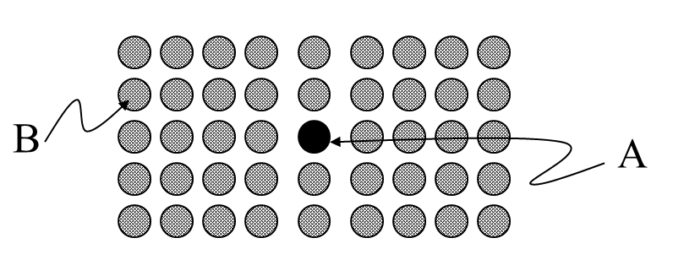
Raoult’s law
An important assumption for Raoult’s law
It assume the magnitudes of the A–A, B–B, and A–B bond energies in the solution be identical, in which case the depth of the potential energy well of an atom at the surface is independent of the types of atoms which it has as nearest neighbors
A-B bonding is different from A-A and B-B
And considering a solution, with X_{A} <<1
For B, most of B still interacted with B,
So it will follow Raoult’s law:
For A, it bounded to B, so it no longer follows Raoult’s law

Slide 10
Open question:
Considering the reasonability of the assumption of the “The molar fraction of A in the solution: X_{A} , assume the fraction atom A on the surface is X_{A}” when we derivation the Routian’s law. Explain a case this assumption will not valid, and consider a modification.

Slide 11
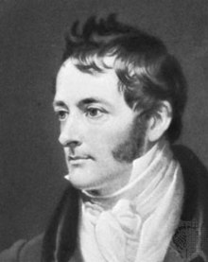
Henry’s law
William Henry
English Chimist
Considering A in a solution, with X_{A} <<1
and A-B bonding is different from A-A and B-B
1744-1836
Raoultian behavior
If A-B bonding is stronger than A-A, A is more difficult to evaporate in solution than pure A
Henrian Behavior
Henry’s law
If A-B bonding is weaker than A-A, A is more difficult to evaporate in solution than pure A

Slide 12
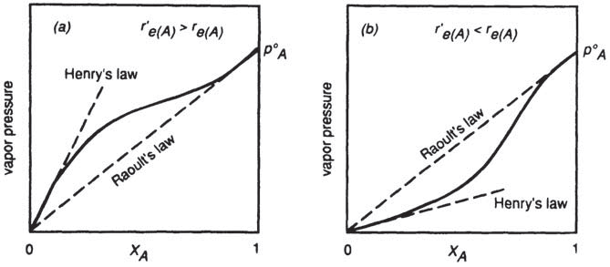
Henry’s law
(a): A-B bonding is weaker than A-A
A-B is less-negative than A-A
Positive deviation
from Raoultian behavior
(b): A-B bonding is stronger than A-A
A-B is more-negative than A-A
Negative deviation
from Raoultian behavior

Slide 13
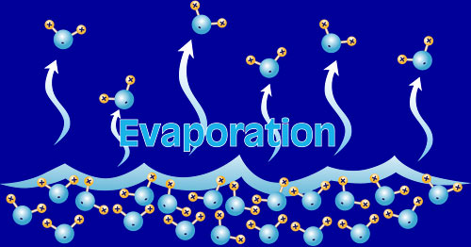
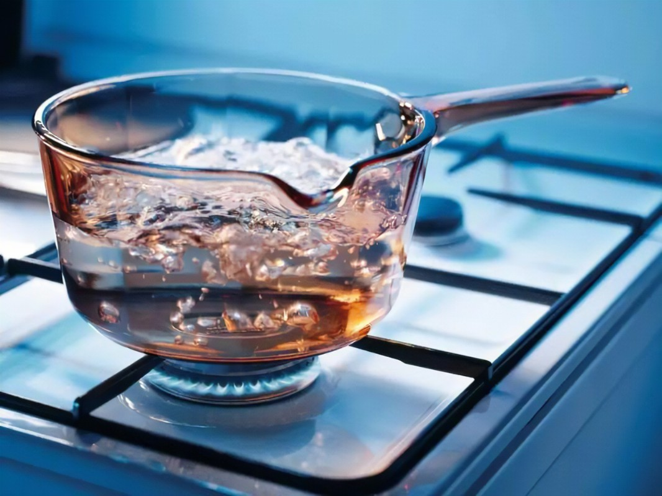
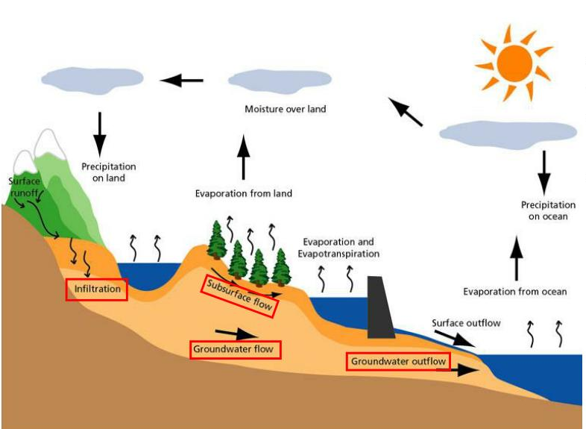
Evaporation
Evaporation:
phase transition
from liquid (water) to gas (vapor)

Slide 14
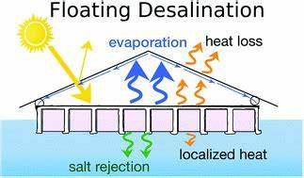
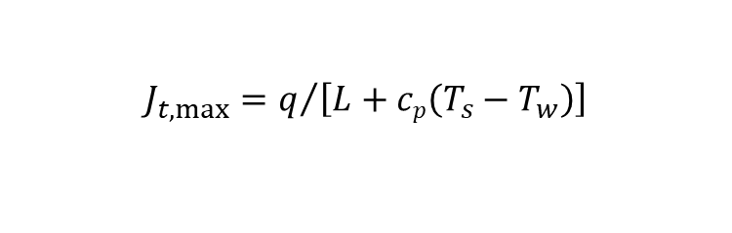
Theoretical Limit for Thermal Evaporation
The theoretical limit for thermal evaporation, using solar or LED energy or electrical sources, can be calculated from
$$J_{t,max}=q/{\left[L+cp\left(T_{s}−T_{w}\right)\right]}$$
𝑞 solar flux or other forms of input power
𝐿 the latent heat, 2257.2kJ/kg
𝑐_{𝑝} the constant-pressure specific heat,
𝑇_{𝑠} evaporating surface
𝑇_{𝑤} bulk water temperatures.
Assuming all solar flux converts into heat used for water evaporation.
taking 𝑇_{𝑠} = 40℃ and 𝑇_{𝑤} = 20℃ , and standard solar flux at one sun 𝑞 = 1 kW/m² , the thermal evaporation limit is 𝑚̇ = 1.45 kg/(m²h),

Slide 16
A Hierarchically Nanostructured Gel
Limit for
Thermal
Evaporation
A hierarchically nanostructured gel (HNG) based on polyvinyl alcohol (PVA) and polypyrrole (PPy) that serves as an independent solar vapor generator
A floating HNG sample evaporated water with a record high rate of 3.2 kg m⁻² h⁻¹ via 94% solar energy from 1 sun irradiation,

Slide 17
A New Insight in Solar Derived Water Evaporation
evaporation rates for both PVA-PPY and pure-PVA samples exhibit a peak evaporation rate at 520 nm wavelength.
the absorptance itself does not show peaks in the visible spectrum

Slide 18
For energy conservation, a typical hydrogen bond energy in water is 0.26 eV, which does not match that of a photon at 500 nm with an energy of 2.48 eV.
the bonds within a cluster are dominantly hydrogen bonds, the bonding of a cluster with its environment is usually non-hydrogen-bond, i.e., the van der Waals bond, which is only ~0.013 eV
if a 500 nm photon can cleave off a water cluster, it will break at least 10 hydrogen bonds or ~100 van der Waals bonds.

Slide 19
Photomolecular effect

Slide 21

“We are wondering whether the fact that leaves are green, i.e., plants avoid green light, is related to our observation that the photomolecular rate is highest at these wavelengths. After all, biological organisms emerged way after the earth has water and sunlight. ”
----- Gang Chen

Slide 22
29. Thermodynamic activity of a component in a solution
Ref. Introduction of Thermodynamics of Materials, D. R. Gaskell, Chapter 9

Slide 23
Thermodynamic Activity
Thermodynamic activity ( a_{i} ) of a component in any state at the temperature T is formally defined as being the ratio of the fugacity of the substance in that state to its fugacity in its standard state
f_{i} is the vapor’s fugacity of component i in solution
f_{i} º is the vapor’s fugacity of pure I at the same temperature
If vapor phase is idea

Slide 24
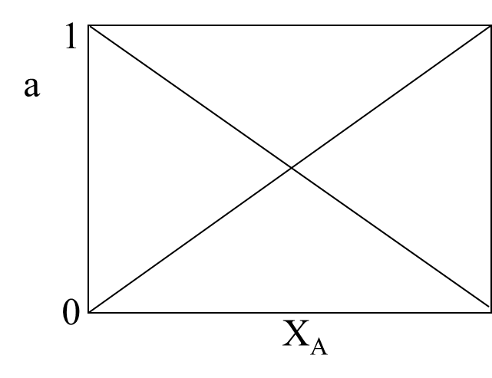
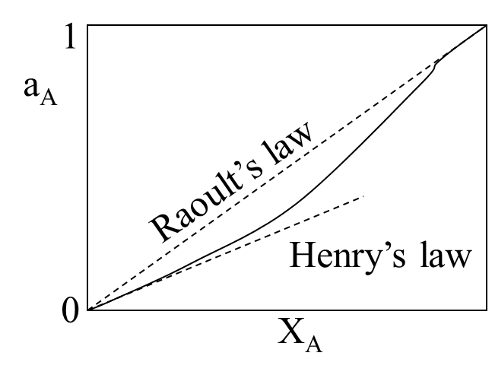
Thermodynamic Activity
The solution
following Raoult’s law
The solution
following Henry’s law
a_{i} =X_{i}
Dalton law of partial pressure

Slide 25
Gibbs-Duhem Equation
Any extensive property, say Q: Q’ = Q’(T, P, n₁, n₂, …)
At constant T and P:
is the value of Q per mole of i in the solution
Gibbs-Duhem equation

Slide 26
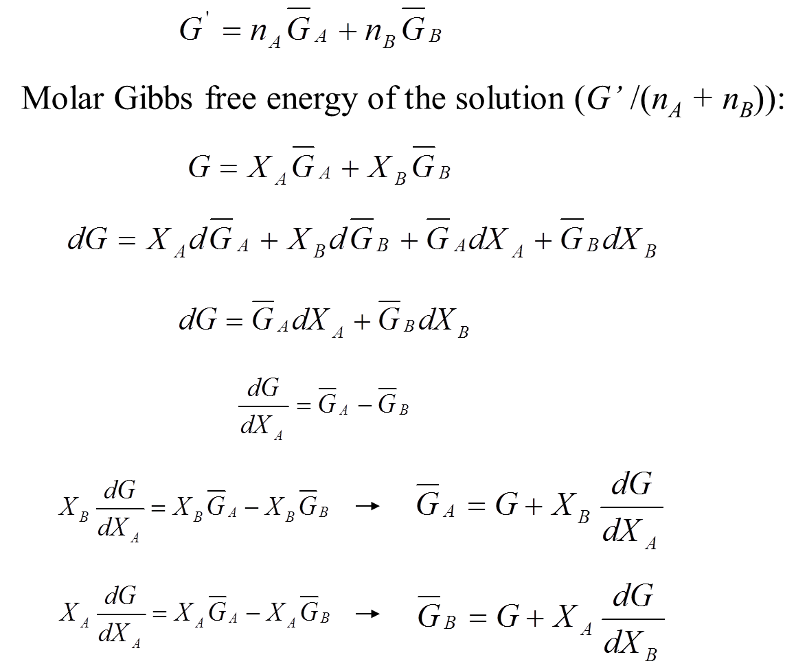
G of a Solution

Slide 27
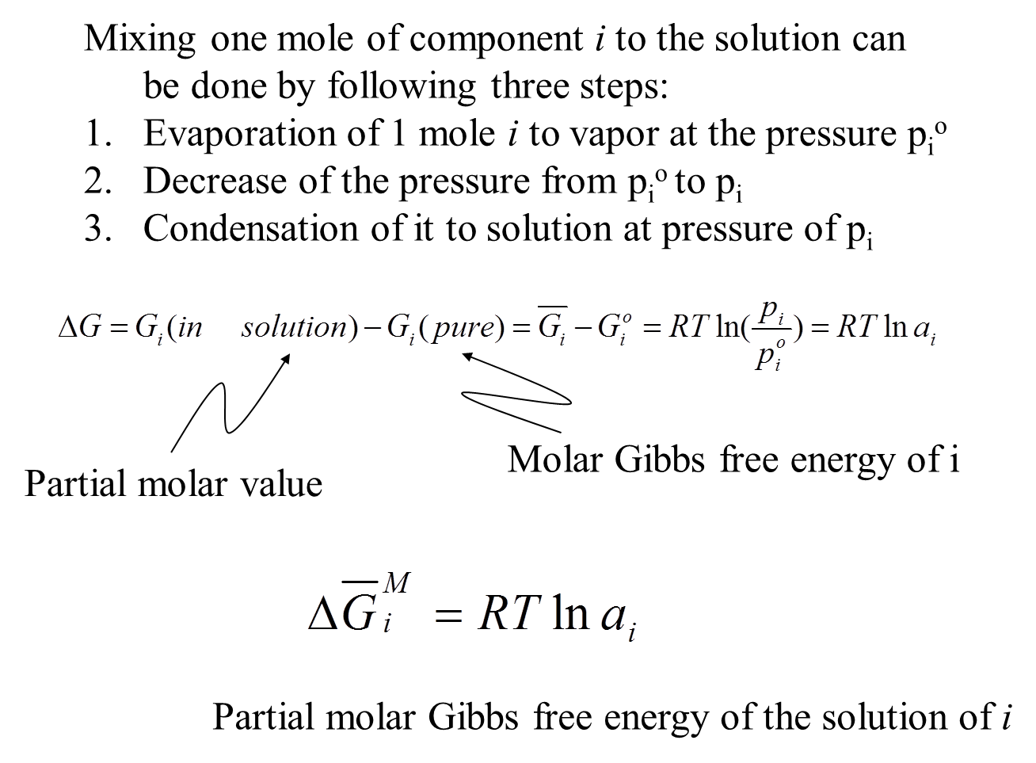
ΔG due to Formation of a Solution

Slide 28




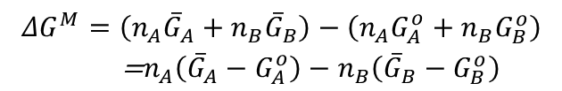
ΔG due to Formation of a Solution
If n_{A} moles of A and n_{B} moles of B are mixed to form a solution at constant temperature and pressure,
The Gibbs free energy before mixing =
$$n_{A}G_{A}^{o}+n_{B}G_{B}^{o}$$
The Gibbs free energy after mixing =
$$n_{A}{\overline{G}}_{A}+n_{B}{\overline{G}}_{B}$$
Substitution from Eq.(9.28)
The change in the Gibbs free energy caused by the mixing process
$$ΔG_{i}^{M}={\overline{G}}_{i}−G_{i}^{0}=RTlna_{i}$$
$$\begin{matrix}ΔG^{M}=\left(n_{A}{\overline{G}}_{A}+n_{B}{\overline{G}}_{B}\right)−\left(n_{A}G_{A}^{o}+n_{B}G_{B}^{o}\right) \\ \text{ =}n_{A}\left({\overline{G}}_{A}−G_{A}^{o}\right)−n_{B}\left({\overline{G}}_{B}−G_{B}^{o}\right)\end{matrix}$$
$$ΔG^{M}=n_{A}{\overline{G}}_{A}^{M}+n_{B}{\overline{G}}_{B}^{M}$$

Slide 29
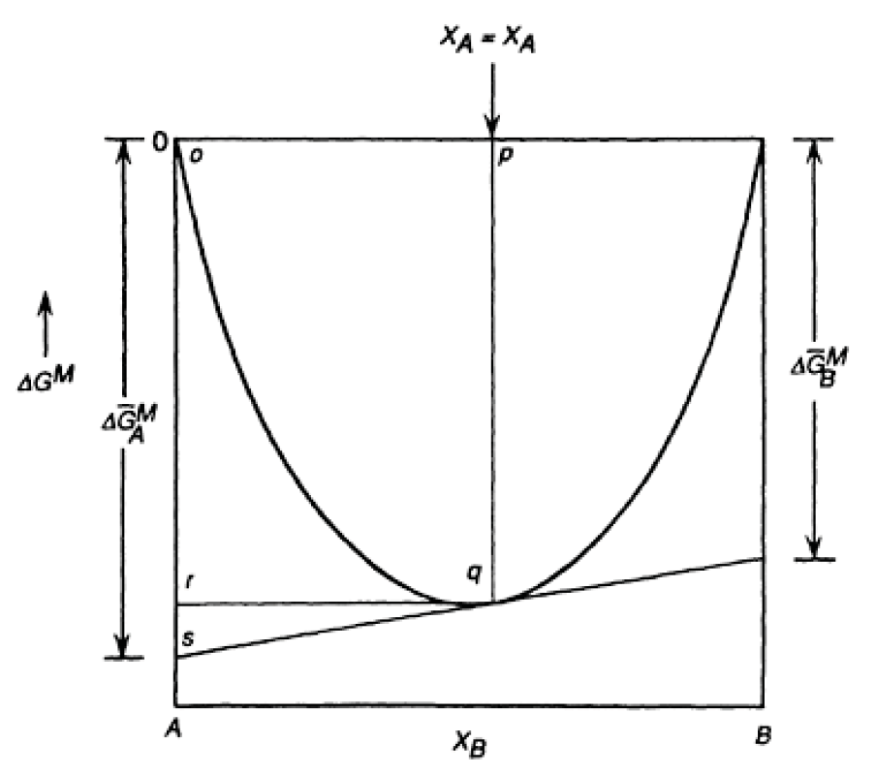
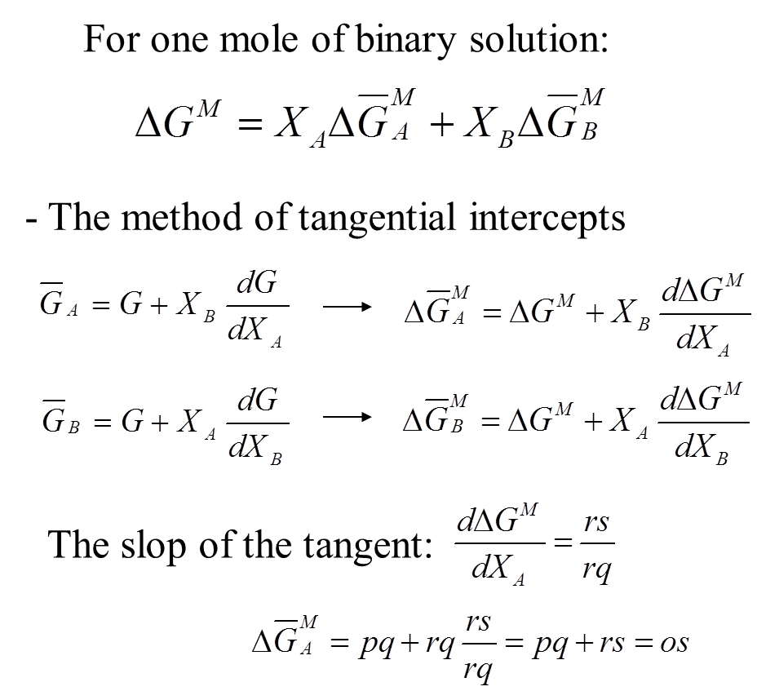
ΔG due to Formation of a Solution
The Method of Tangential Intercepts
The method is used to obtain
the partial molar values of any extensive property from the variation, with composition, of the integral value of the property.

Slide 30
30. The behavior of the ideal solution
Ref. Introduction of Thermodynamics of Materials, D. R. Gaskell, Chapter 9

Slide 31


Raoultian ideal solution
For a Raoultian ideal solution
For idea gas mixtures
For an ideal binary A–B solution
p_{i} is the partial pressure
P_{i} is the pressure
The general thermodynamic relationships between the state properties of a system are applicable to the partial molar properties of the components of a system

Slide 32
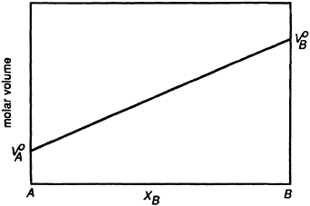
Volume change of ideal solution
Volume change due the formation of a solution
it is seen that the change in volume accompanying an ideal solution is zero
The volume of an ideal solution is thus equal to the sum of the volumes of the pure components.

Slide 33
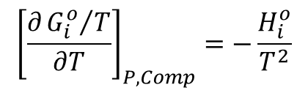
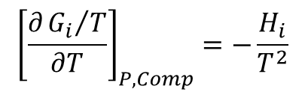
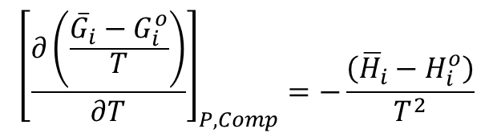
Heat of Formation of an ideal Solution
According to Gibbs-Helmholtz equation:
$${\left[\frac{∂{G_{i}}/T}{∂T}\right]}_{P,Comp}=−\frac{H_{i}}{T^{2}}$$
For the pure component:
$${\left[\frac{∂{G_{i}^{o}}/T}{∂T}\right]}_{P,Comp}=−\frac{H_{i}^{o}}{T^{2}}$$
Hence:
$${\left[\frac{∂\left(\frac{{\overline{G}}_{i}−G_{i}^{o}}{T}\right)}{∂T}\right]}_{P,Comp}=−\frac{\left({\overline{H}}_{i}−H_{i}^{o}\right)}{T^{2}}$$

Slide 34
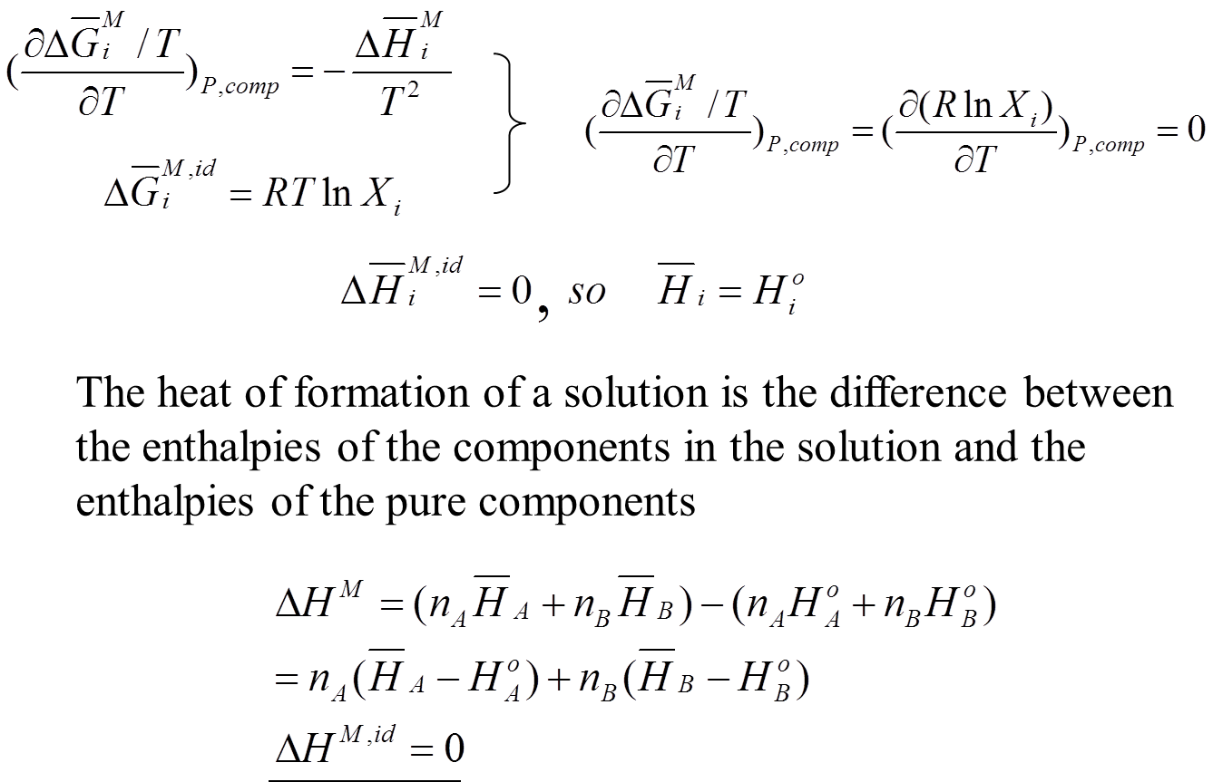
Heat of Formation of an ideal Solution
Gibbs-Helmholtz equation

Slide 35
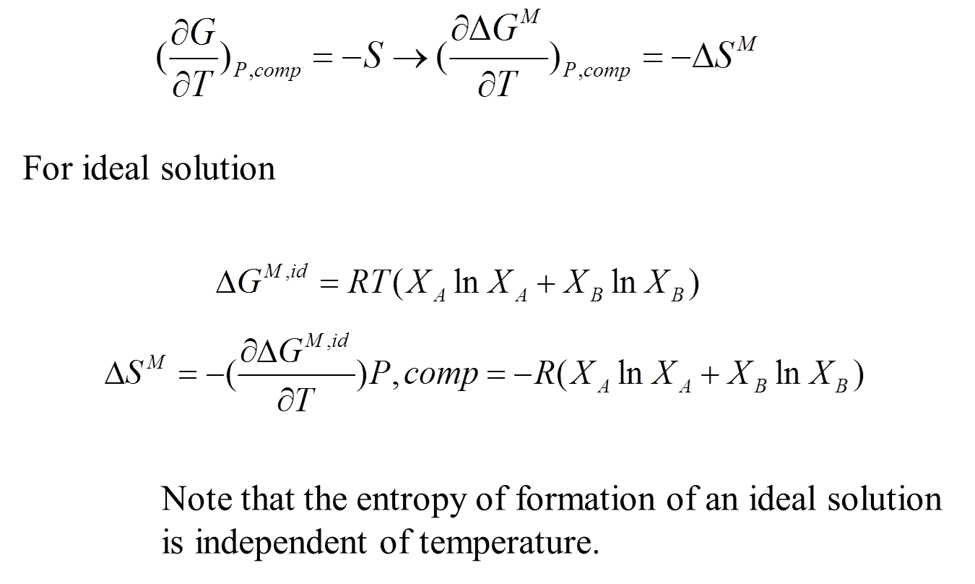
Entropy of Formation of an ideal Solution

Slide 36
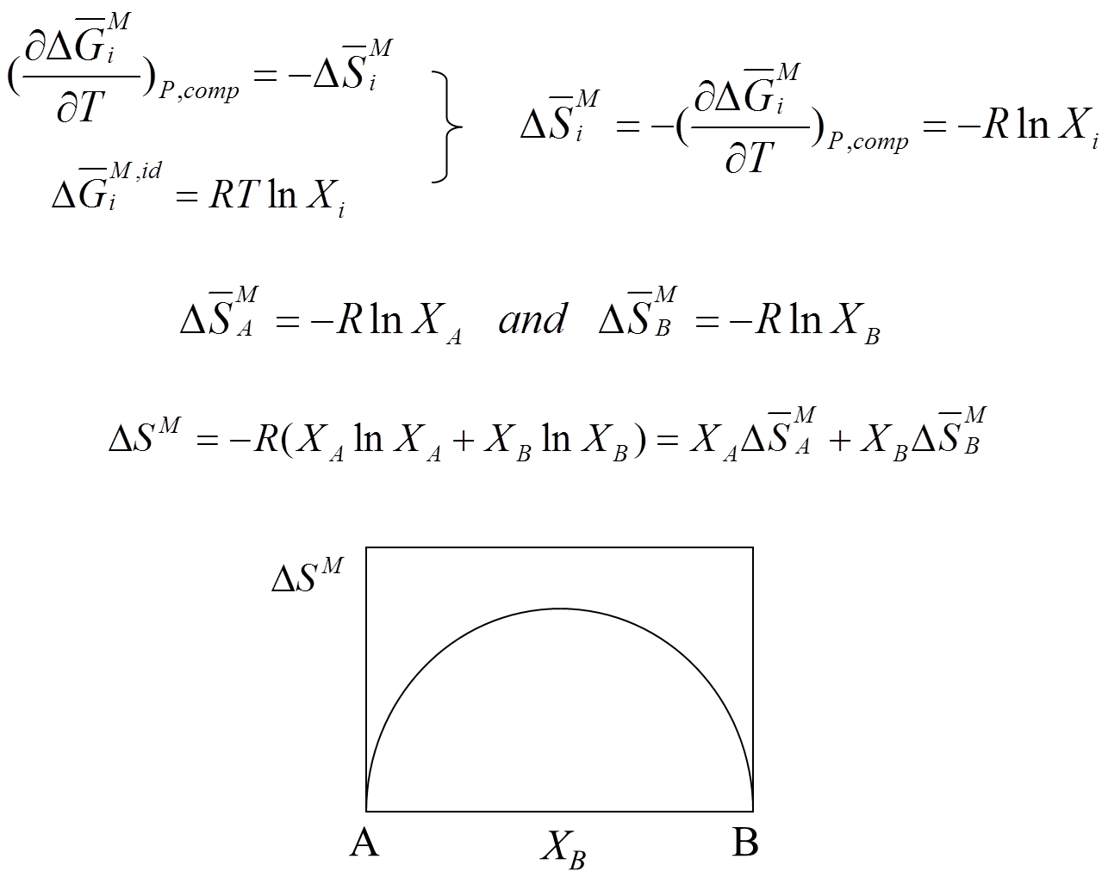
Entropy of Formation of an ideal Solution

Slide 37
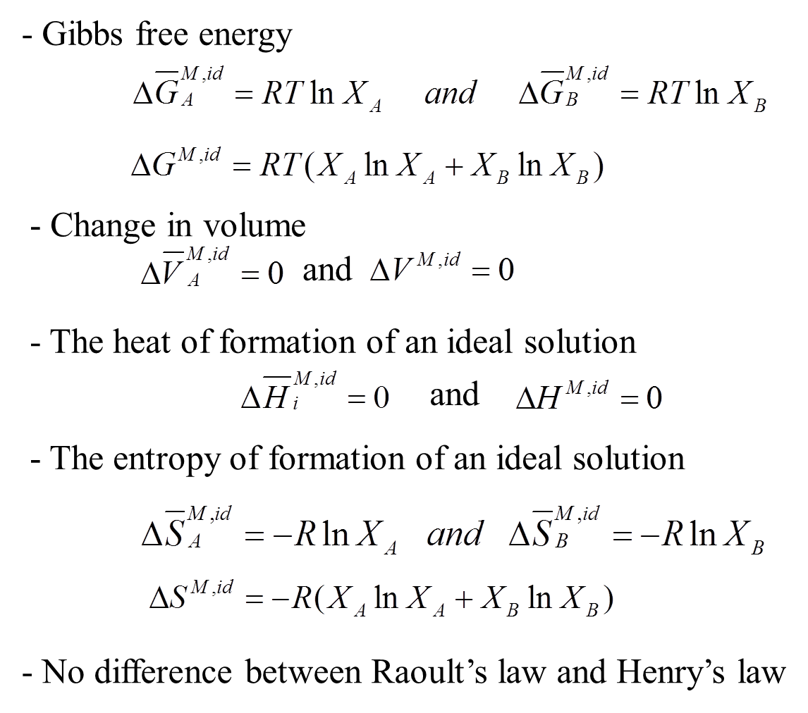
Entropy of Formation of an ideal Solution

Slide 38
Open Question？
Is possible directed measure the interaction of molecular in a solution, design a possible experiment!

Slide 39
Next lecture
Non-ideal solutions
Regular solutions
Sub-regular solutions

